Slide 1
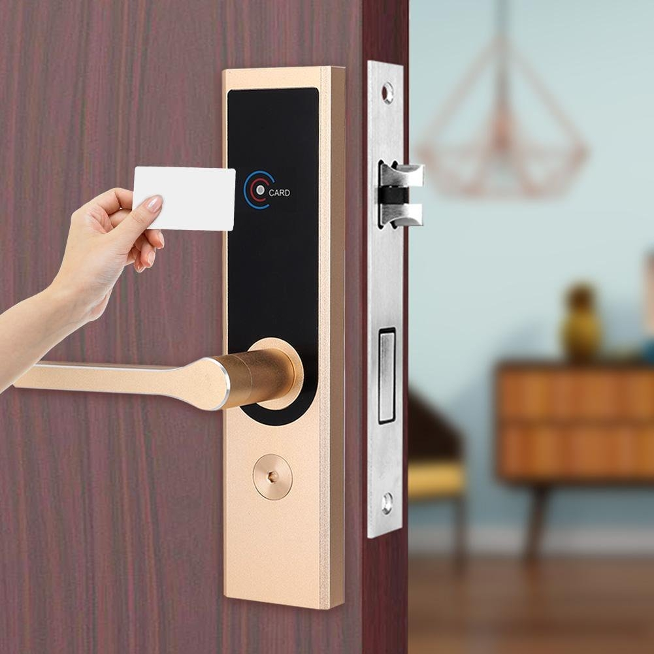
Door Lock System 8051 PROJECT – TEAM 3T
Giảng viên hướng dẫn: thầy Nguyễn Ngọc Tiền

Slide 2



TEAM 3T
VO NHAT TRUONG
TRAN NGOC THANG
NGUYEN BACH THONG

Slide 3
TABLE OF CONTENTS
1
INTRODUCTION
2
HARDWARE
3
SOFTWARE
4
DEMO
5
PROS & CONS
6
FUTURE DEVELOPMENT

Slide 4
1
INTRODUCTION

Slide 5
Some common authentication methods used in smart lock systems:
Physical Key
PIN Code / Password
RFID / NFC
Bluetooth
Wi-Fi
Biometric Authentication

Slide 6
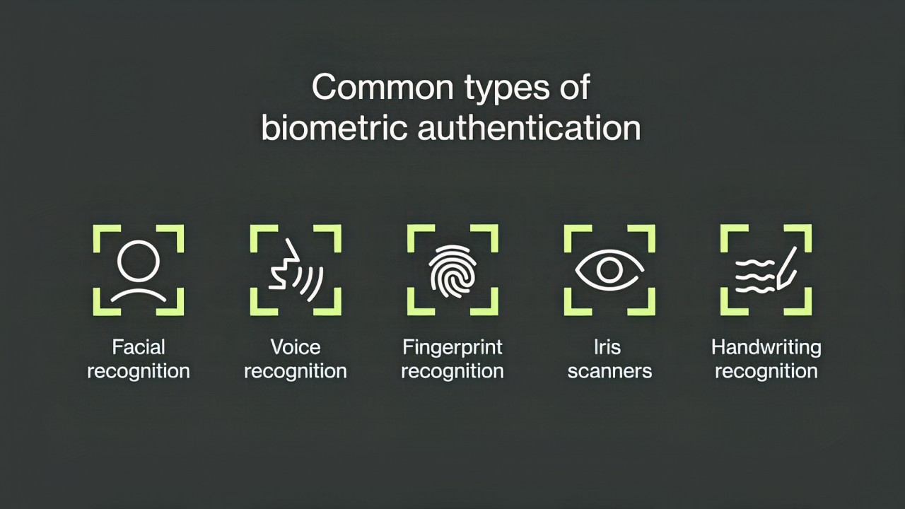
Some common authentication methods used in smart lock systems:
Physical Key
PIN Code
RFID/NFC
Bluetooth
Wi-Fi
Biometric Authentication

Slide 7
Some common authentication methods used in smart lock systems:
Physical Key
PIN Code / Physical Key
RFID /NFC
Bluetooth
Wi-Fi
Biometric Authentication

Slide 8
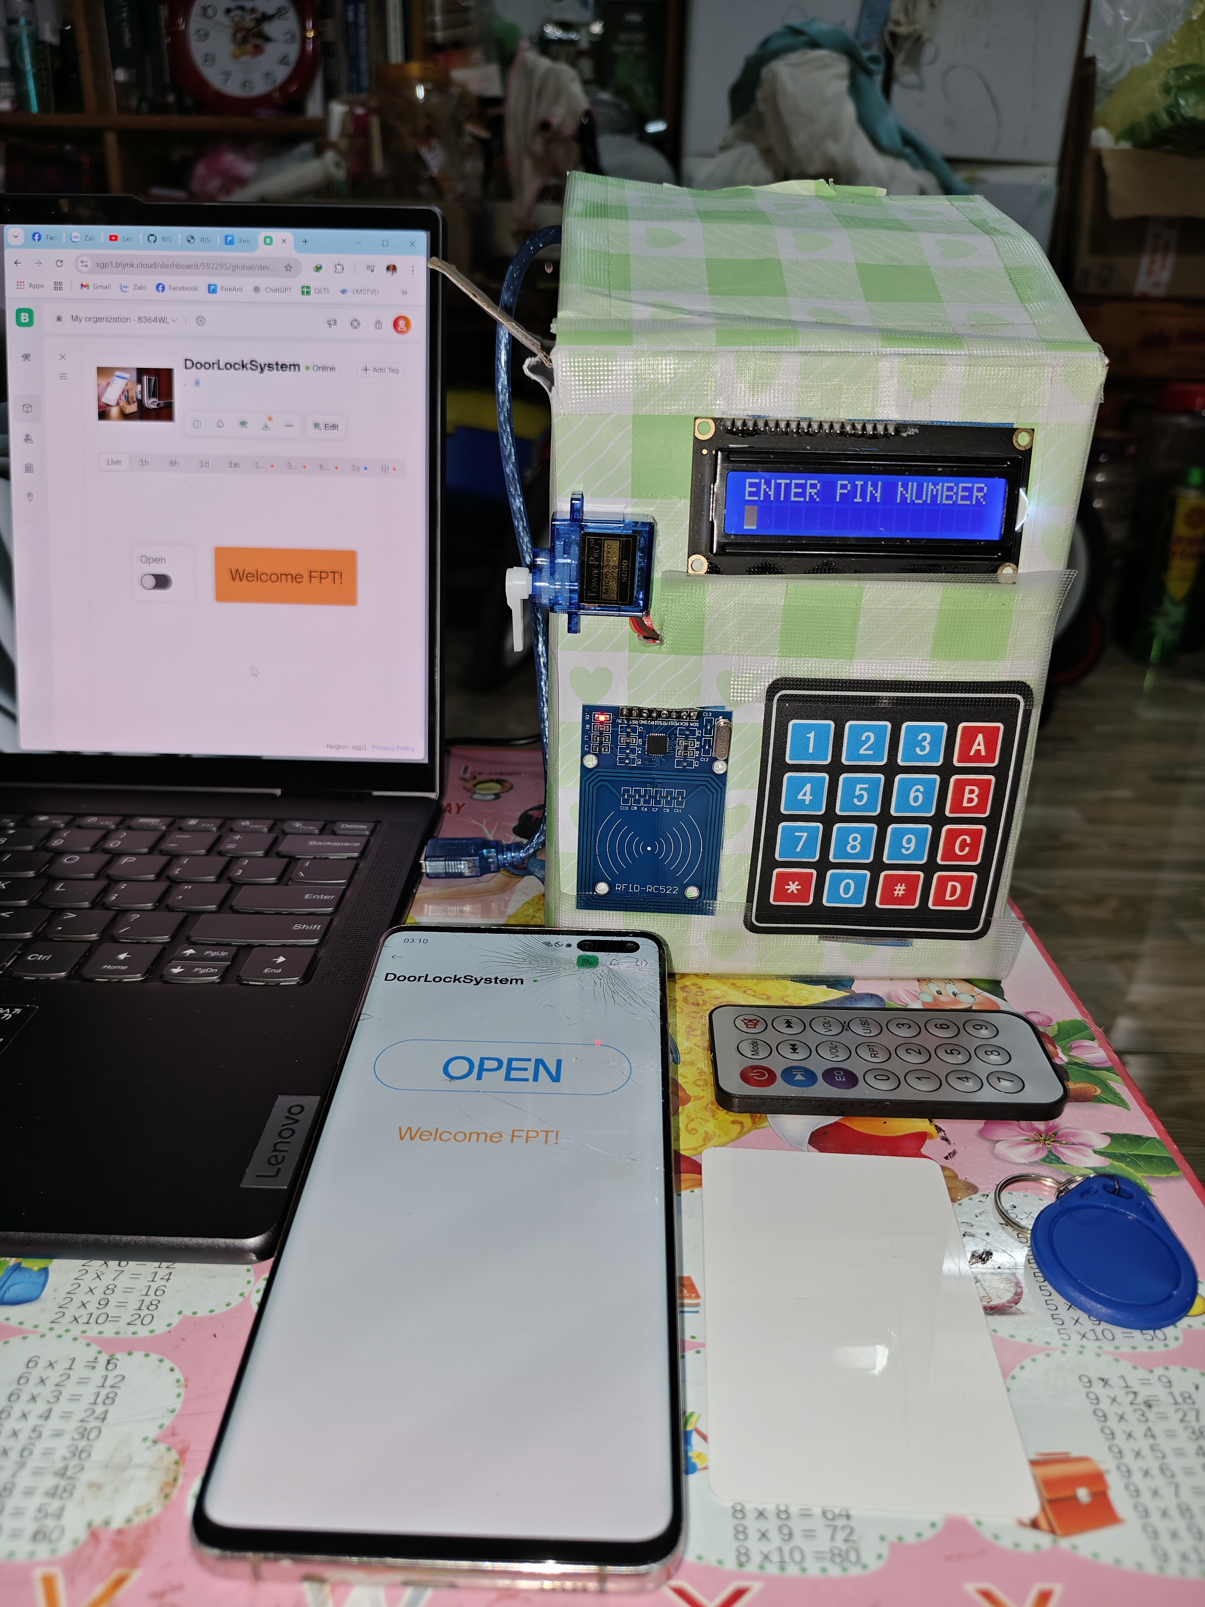

Slide 9
2
HARDWARE

Slide 10
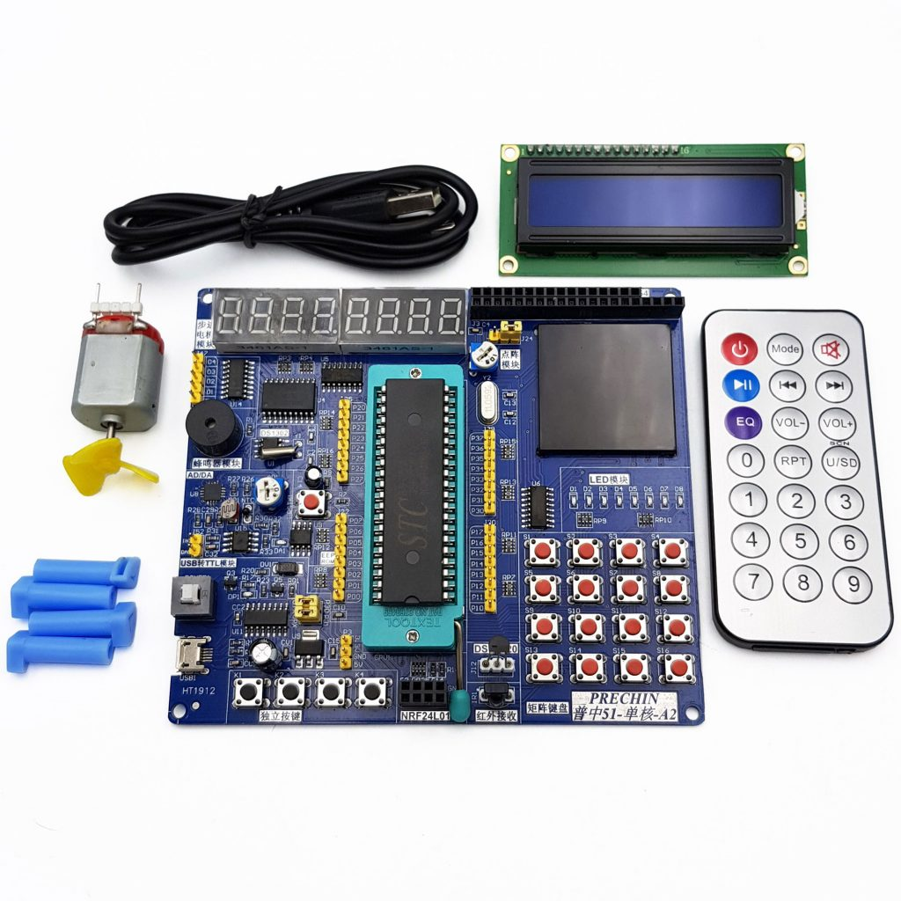
8051 Kit Pro
IC 89C52
LCD 16x2
Keypad
IR Remote
EEPROM 24C02
Servo Motor

Slide 11
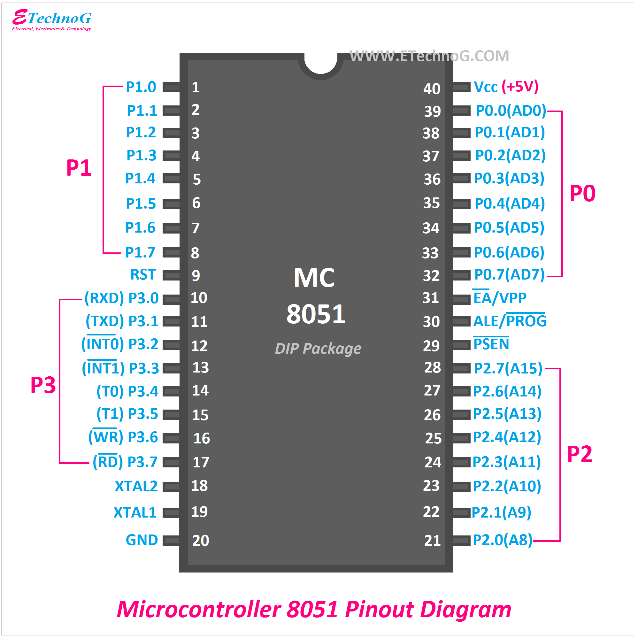
8051

Slide 12
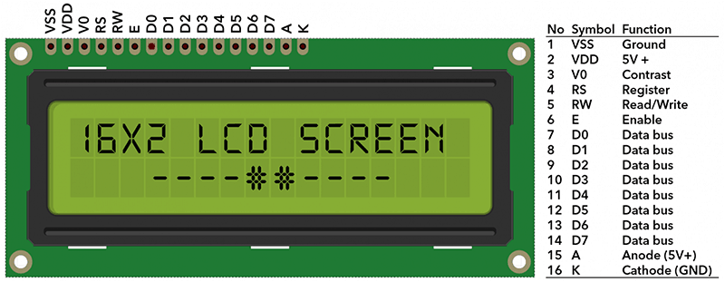
LCD 16x2

Slide 13
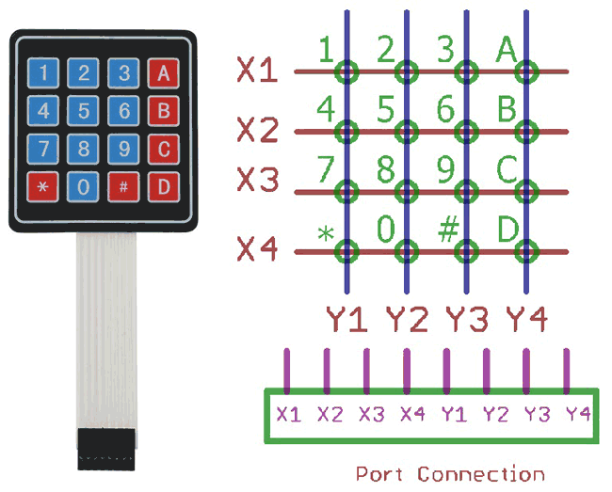
KEYPAD

Slide 14
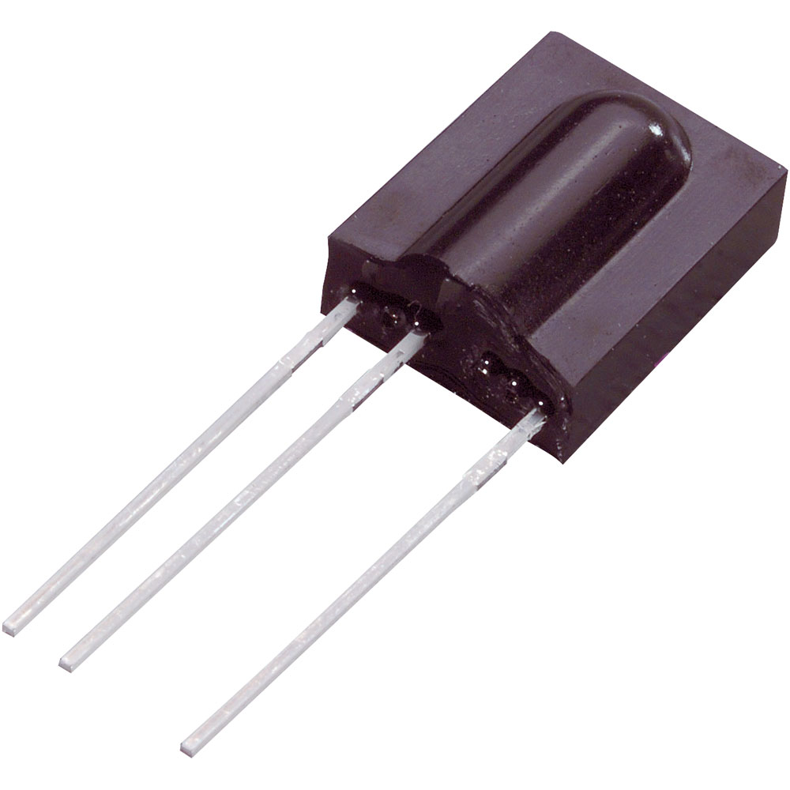
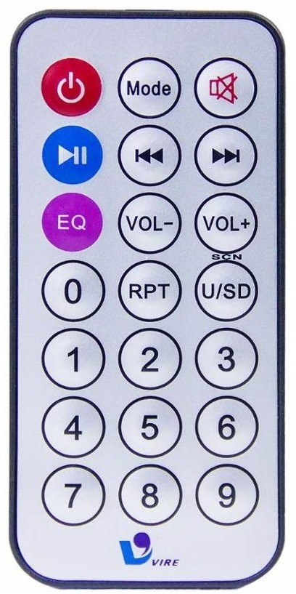
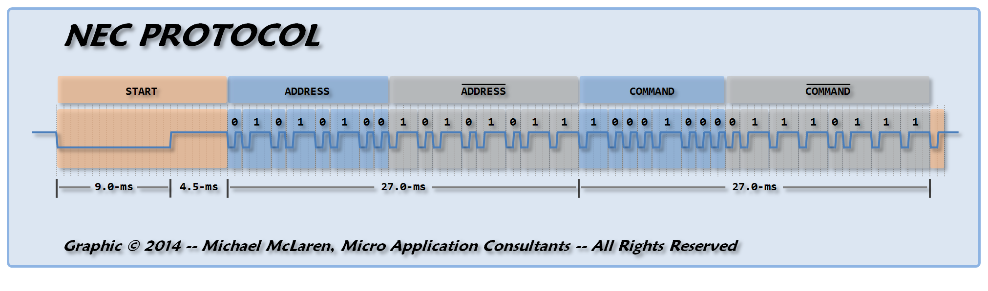
IR Remote
IR remote controller
IR receiver
NEC, RC5, JVC, SIRC

Slide 15
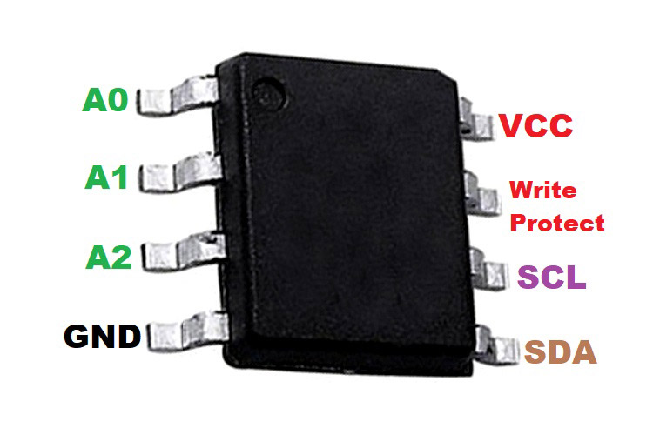
EEPROM 24C02
Electrically erasable programmable ROM
I2C protocol
2Kb ( 256 Byte – 32 pages of 8 bytes)
1 Mil write cycles
100 years

Slide 16
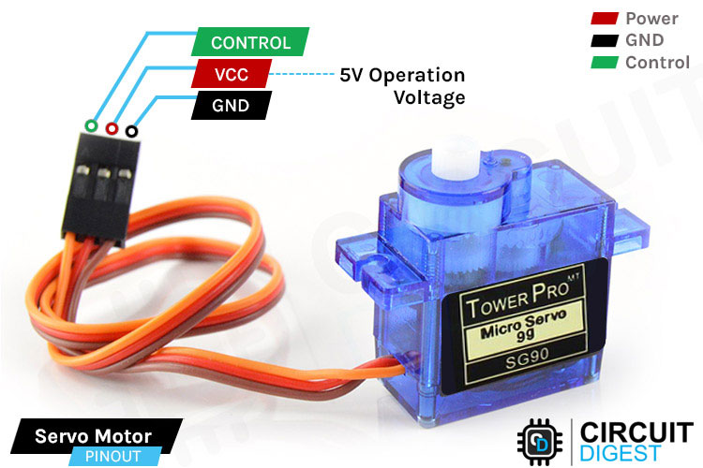
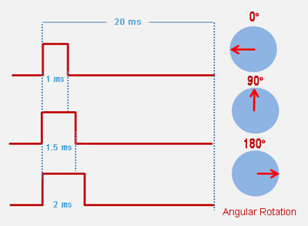
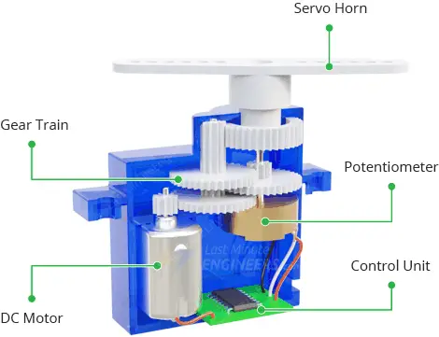
Servo Motor
PWM (pulse width modulation)

Slide 17
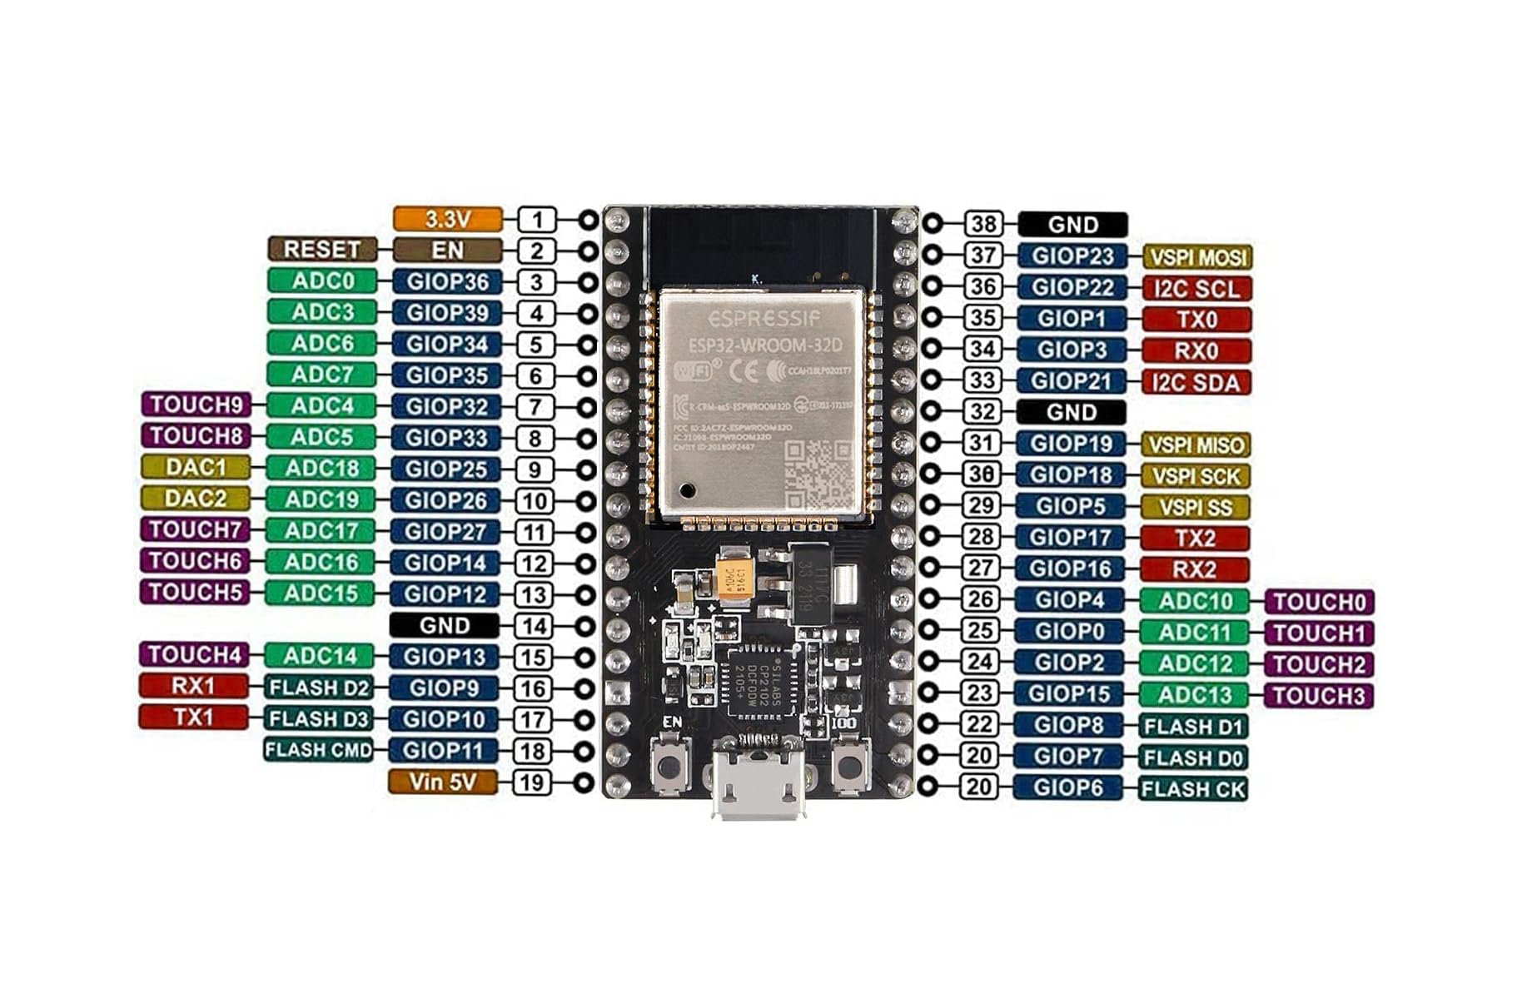
ESP32
UART
SPI
I2C
I2S
PWM
Bluetooth
WiFi

Slide 18
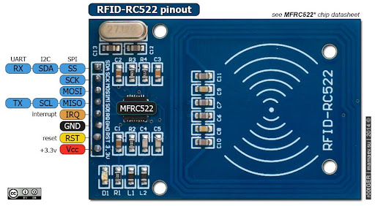
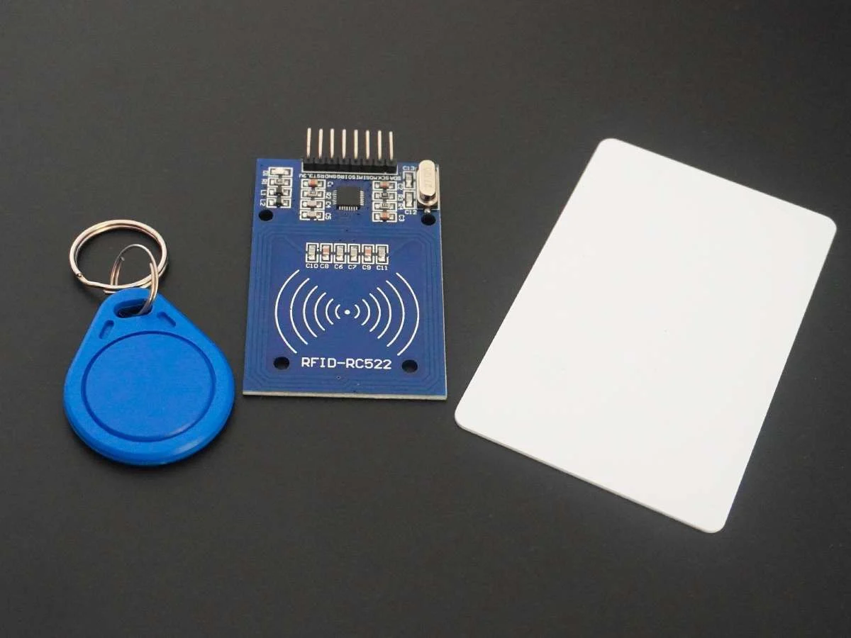
RFID MODULE – RC522
13.56 MHz
SPI protocol
3.3V Power supply

Slide 19
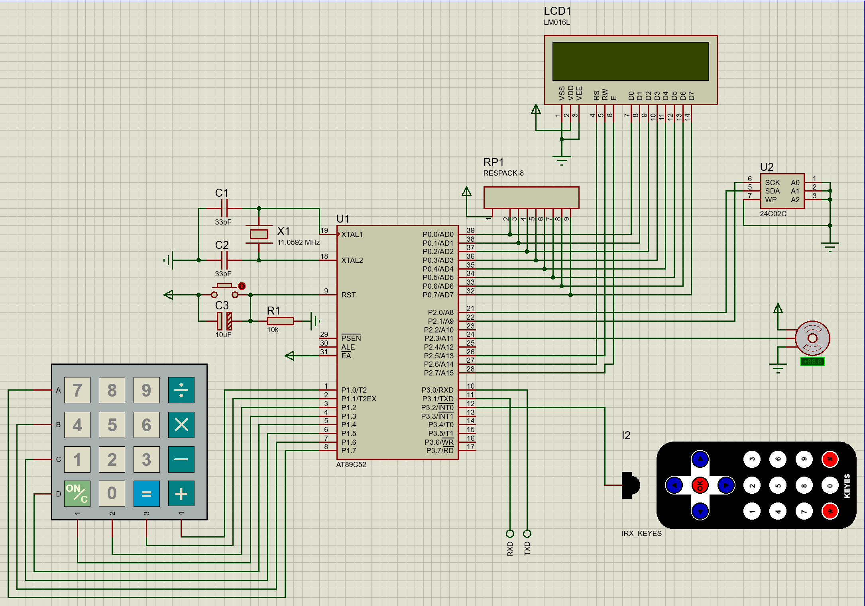

Slide 21
3
SOFTWARE

Slide 22
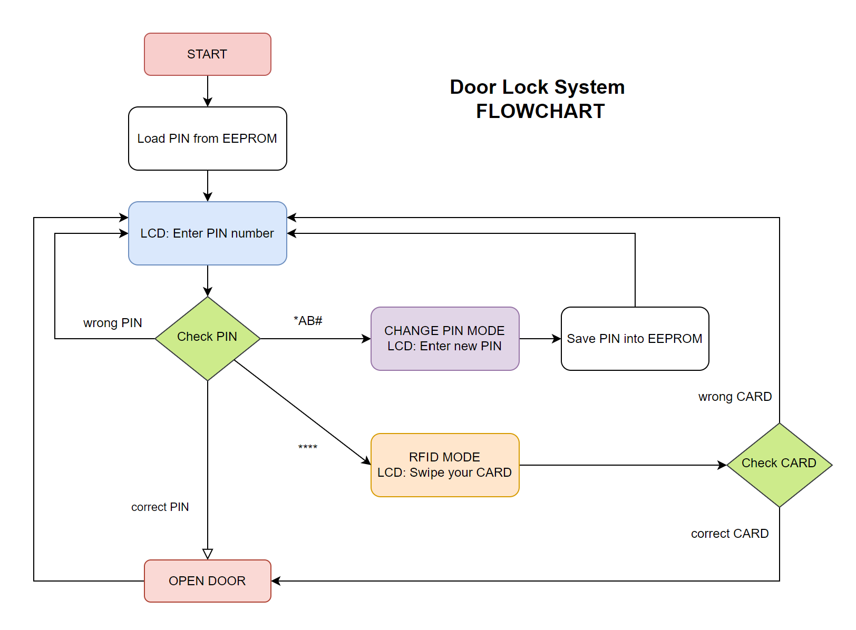

Slide 23
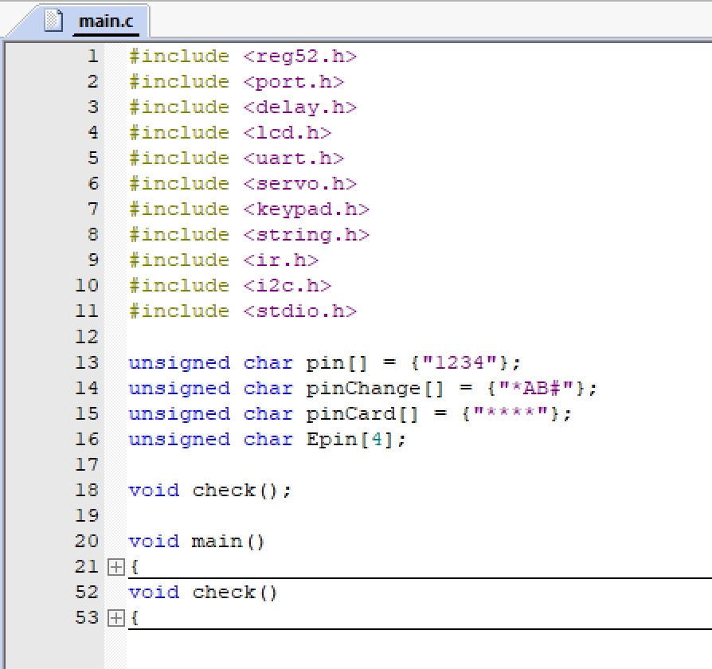
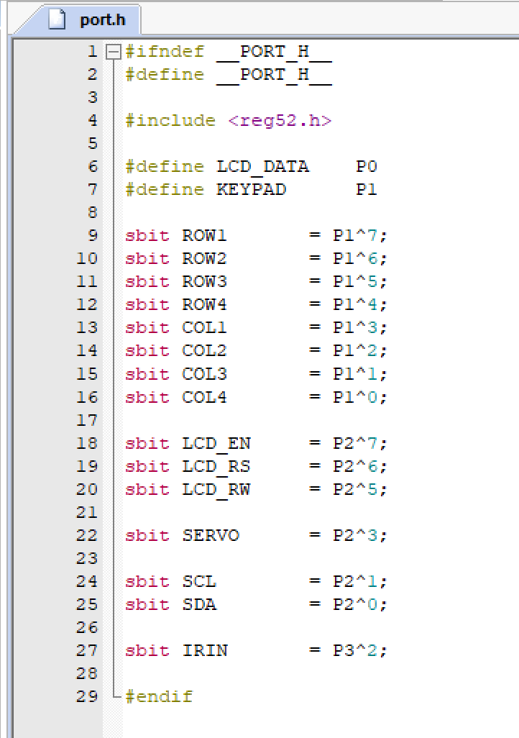

Slide 24
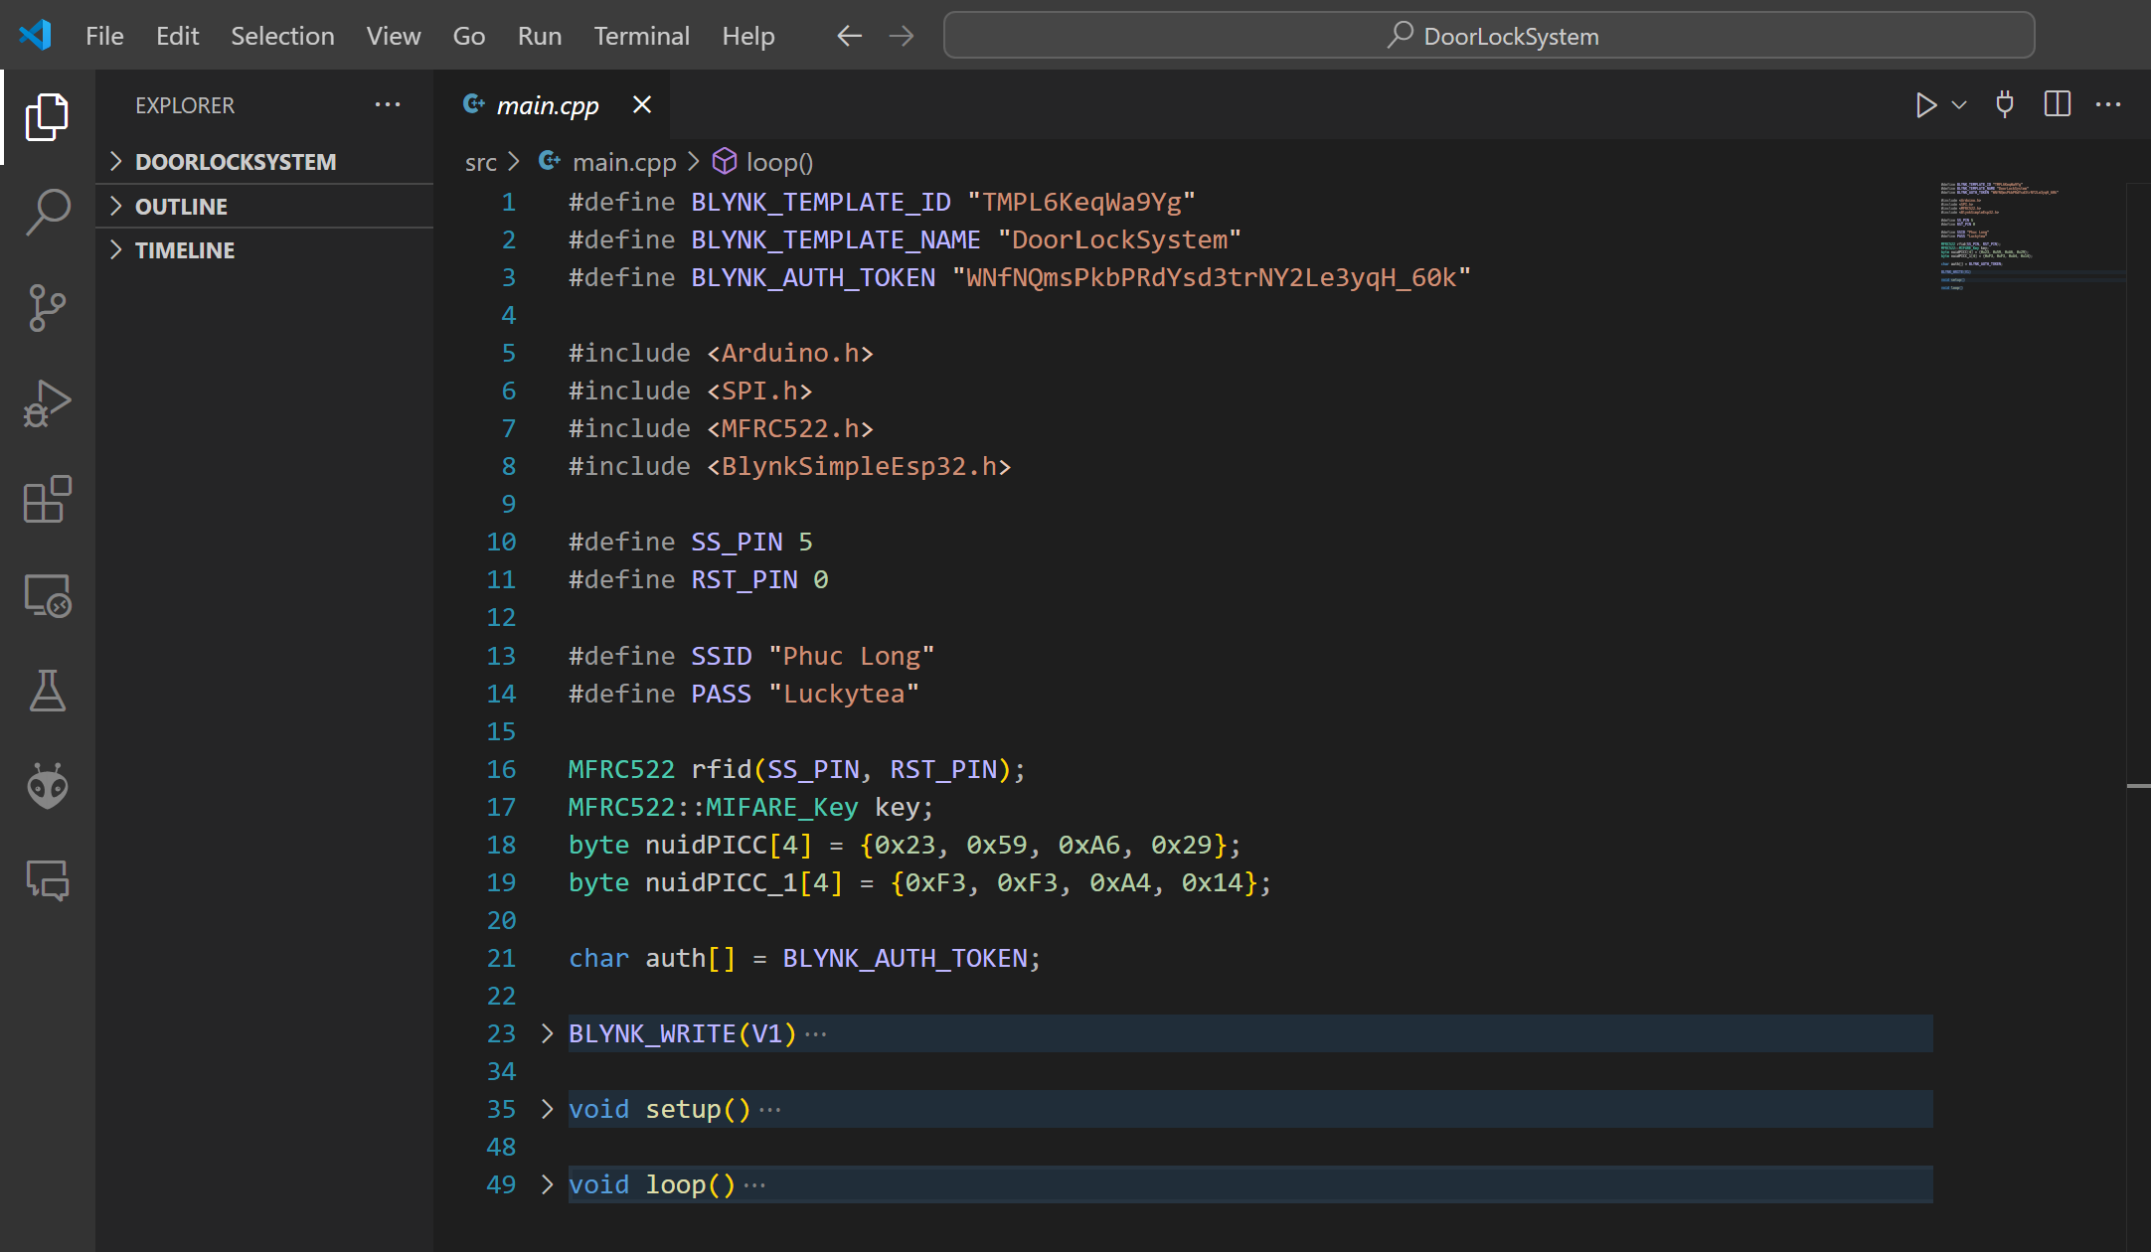

Slide 25
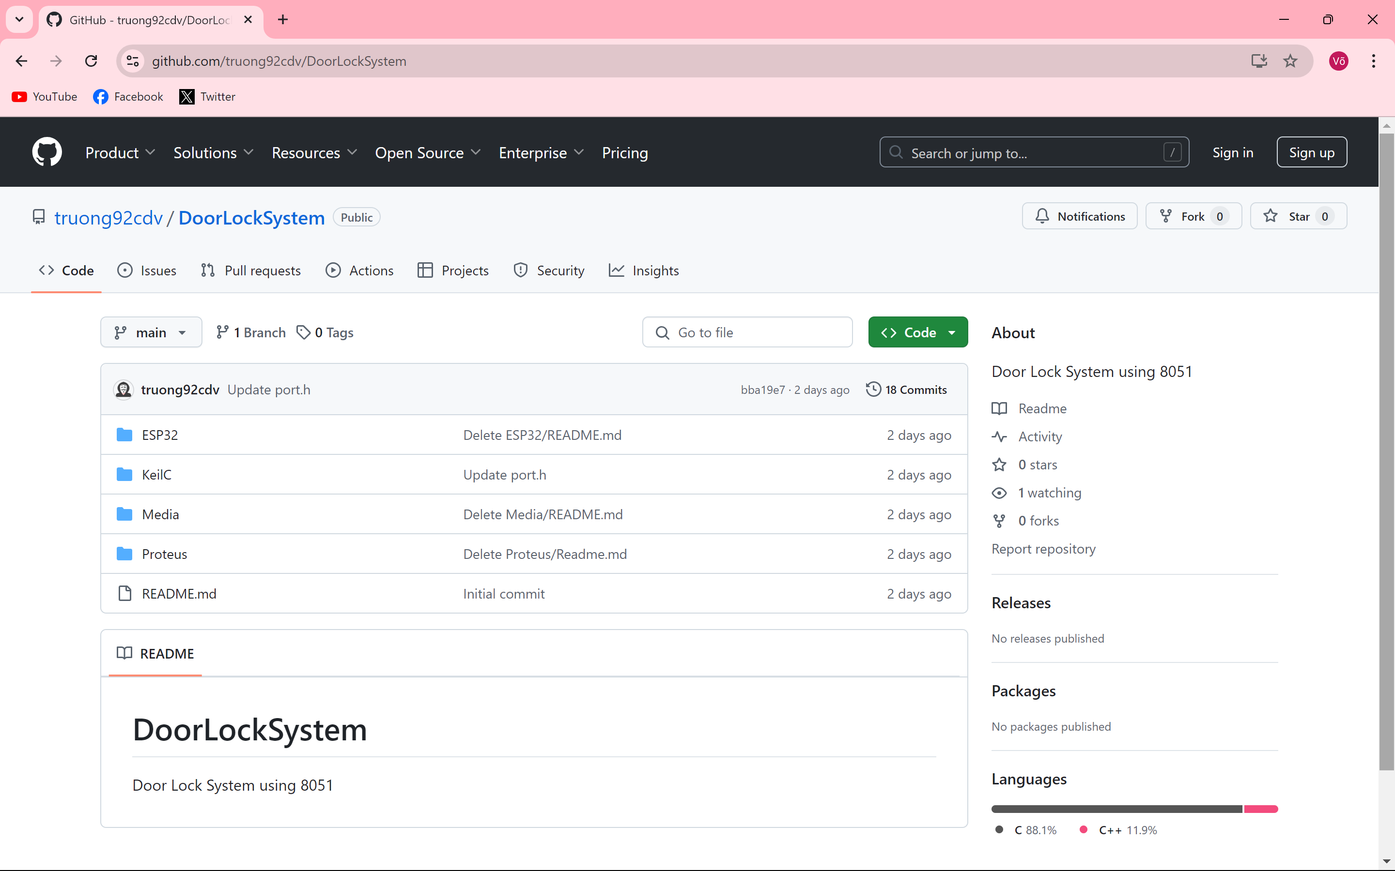
https://github.com/truong92cdv/DoorLockSystem

Slide 26
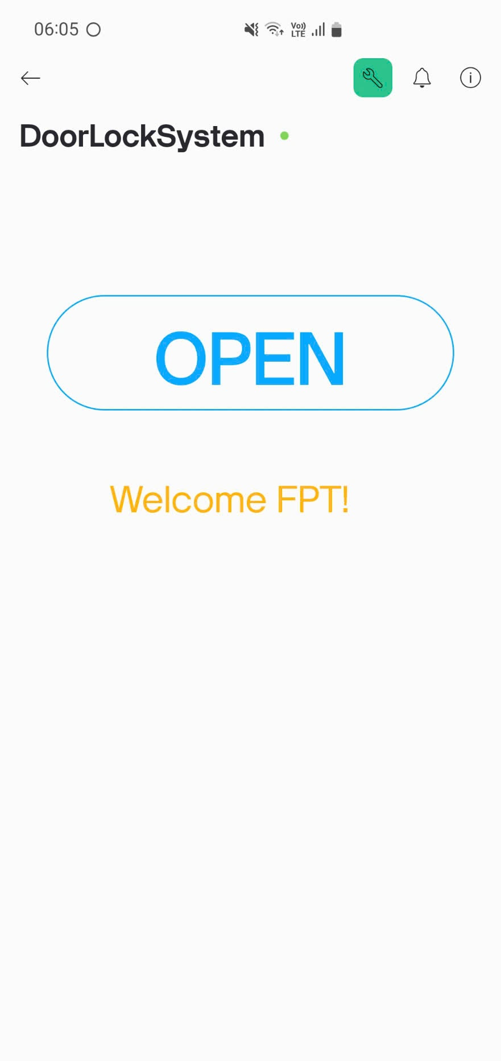
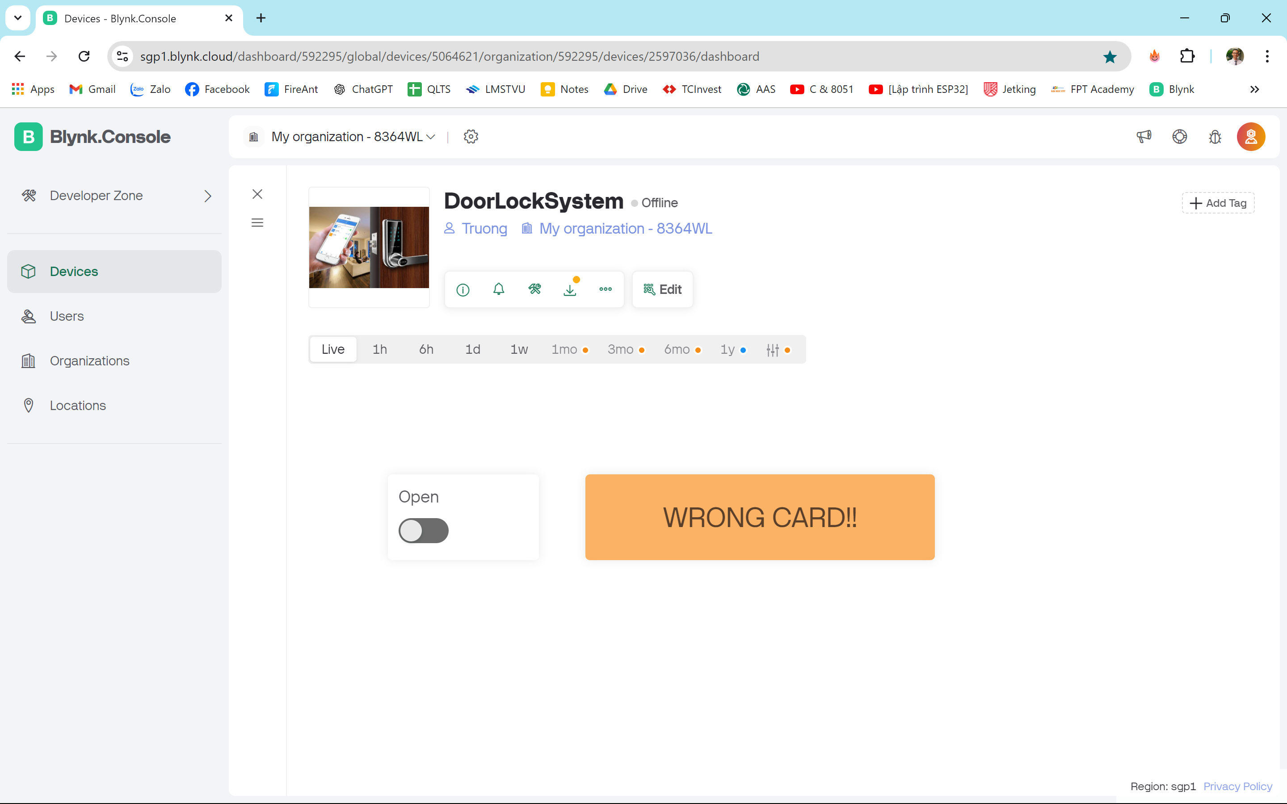

Slide 27
4
DEMO

Slide 28
Video Demo
https://www.youtube.com/watch?v=RTQ9uR0Fonc&t=1s

Slide 29
Video Demo

Slide 30
5
PROS - CONS

Slide 31
Pros
Multi method Auth
Redundant components
Multi protocol
Security
Highly applicable
Lack of advanced features
Cons
PIN code
RFID card
App control with WiFi
Use separate components
Reduce the product size
Only 8051 or ESP32
UART, SPI, I2C
PWM, IR
Cloud connection
Require more secure auth methods
(fingerprint, iris, facial recognition)
Create a more secure app
High practical demand
Door lock system
Attendance Management system
Add new card, remove card
Track system history
SMS alert

Slide 32
6
FUTURE DEVELOPMENT

Slide 33
FUTURE DEVELOPMENT
Remove redundant components Biometric authentication: fingerprint, iris, facial recognition Add new card, remove card Track system history SMS Alert Create a more useful mobile app Smart home integration

Slide 34
THANKS FOR WATCHING
https://github.com/truong92cdv/DoorLockSystem

